Slide 1

Bitcoin Sentiment Analysis
By Jack Willis, Jeff Liu, Mike Sullivan, Raj Tolani, and John Matysek

Slide 2

Project Idea
Given the current volatility in the Bitcoin and overall cryptocurrency market, we wanted to analyze if sentiment from various social media platforms was a good indicator to trade on
Notes:
Mike

Slide 3
Project Background
Social media platforms act as sounding boards for cryptocurrency enthusiasts
These platforms include:
Twitter
Reddit
BitcoinTalk forum
Users discuss the current market which often evokes either positive or negative sentiment on various cryptocurrencies
These users hold some sort of power if you look at the memestock era with AMC and GME, so could they also hold weight in crypto trading?
With Bitcoin being the largest coin, we wanted to see if online chatter has a correlation to buying and selling opportunities
Notes:
Mike

Slide 4

What do we want to find out:
By performing machine learning modeling on the sentiment data scraped from these platforms, could we identify actual alpha to act on or is the noise on these platforms more of a lagging indicator?
Notes:
Mike

Slide 5
Market overview
Bitcoin introduced to the market and blockchain as a whole in 2009 at 0$
First leap did not occur until Spring of 2010 when price rose to $0.09 (not enough people knew how to acquire this currency except a few niche experts)
2011: is when it first breaks 1$ and peaks between $29-$32 over the span of 3 months but bottomed back down to 2$
2013: BTC breaks $100 -> $1000 and then back down to $520 by December.
2014-16: stagnates price and would not touch $1000 again until 2017.
2017: Bull Run sends BTC from under $1000 to almost $19,000 by December
2017-2019: unstable up and down from a high of $17k to a low of $3.2k
2020: Coronavirus starts and pressures inflation on US $, drives BTC to ATH of $29k
2021: BTC soars to ATH of $64k, then plummets to $30k, and then back to ATH of $68k
Currently sits at around 20k price range with many factors of inflation and international conflicts
Notes:
Jeff

Slide 6

Many people in the crypto space turn to social media platforms for information in order to make “strategic” buys and sells.
Relatively new market unlike the 200+ year history of the US Stock Market, it is difficult to find free information to make logical buys/sells.
Augmento was able to provide us with necessary data to use predictive sentiment data with a focus on Bitcoin.

Slide 7
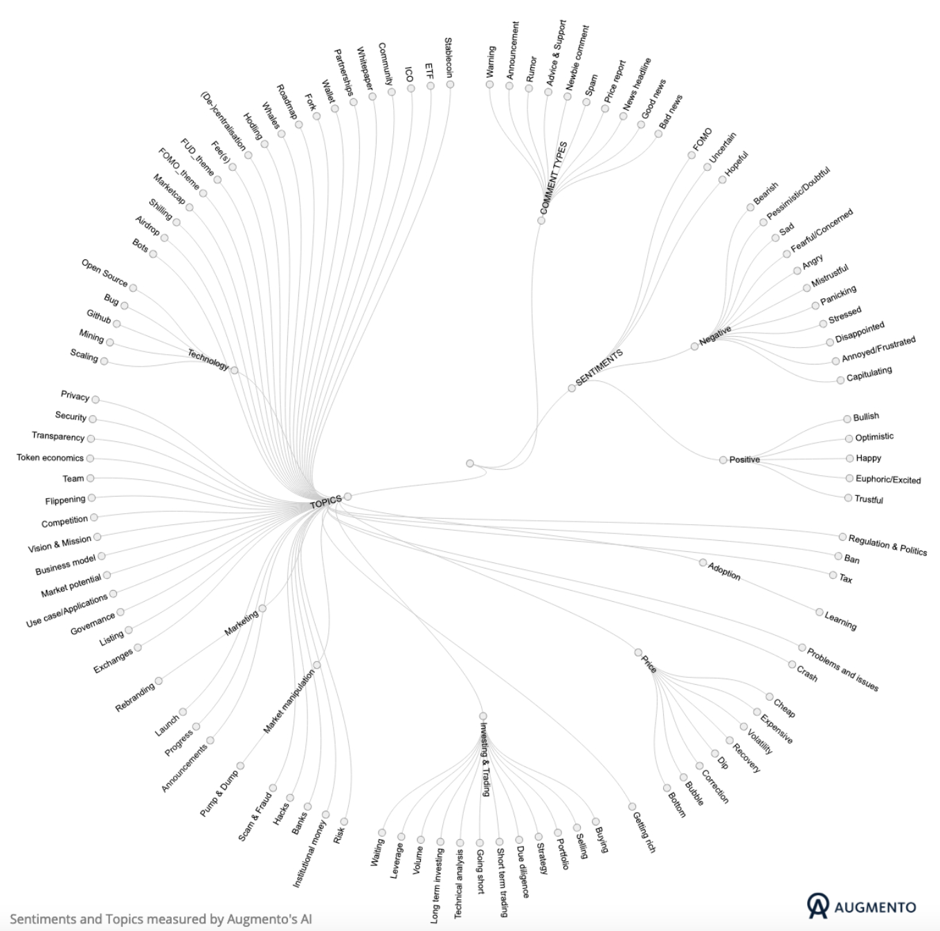
Data Overview
Historic data back to November 2016
93 sentiment categories for over 45+ cryptocurrencies
We sliced the CSV to specific positive and negative sentiments and then aggregated to an overall net score
Notes:
John

Slide 8
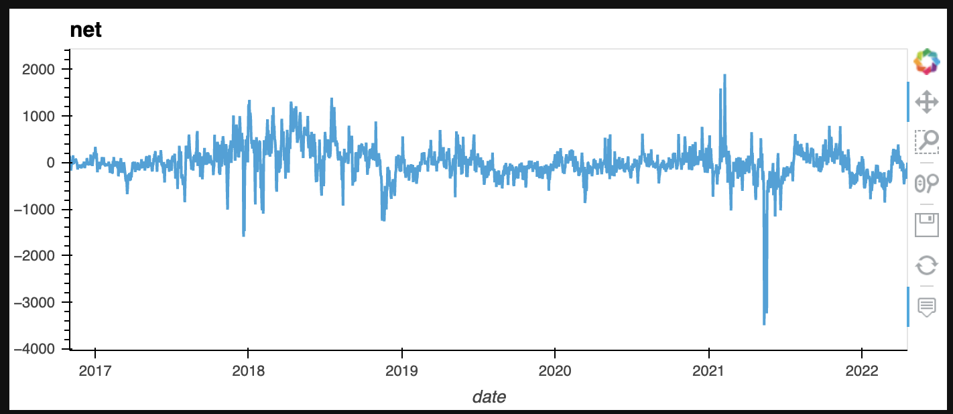
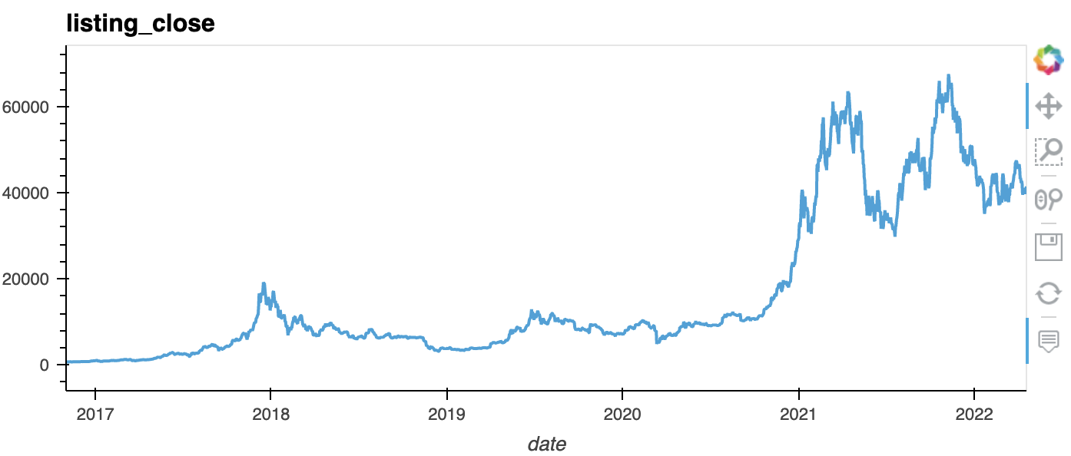
Notes:
John

Slide 9
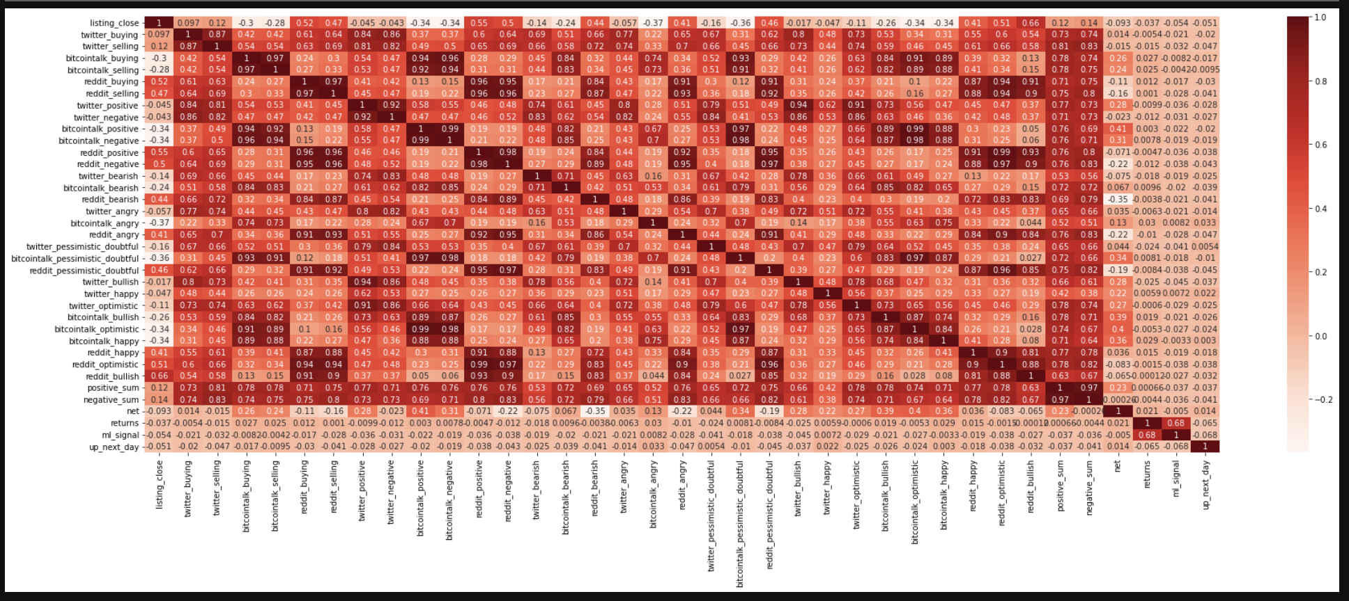
Data Correlation

Slide 10
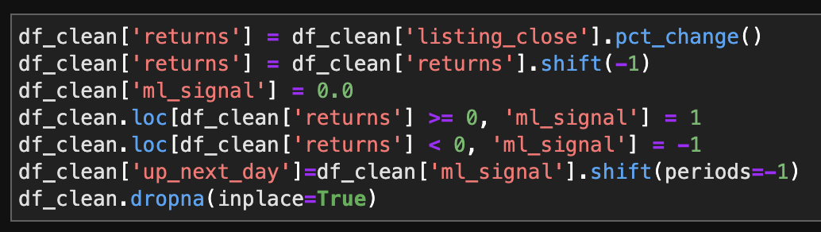
Code Overview
Signal
Notes:
Jack

Slide 11
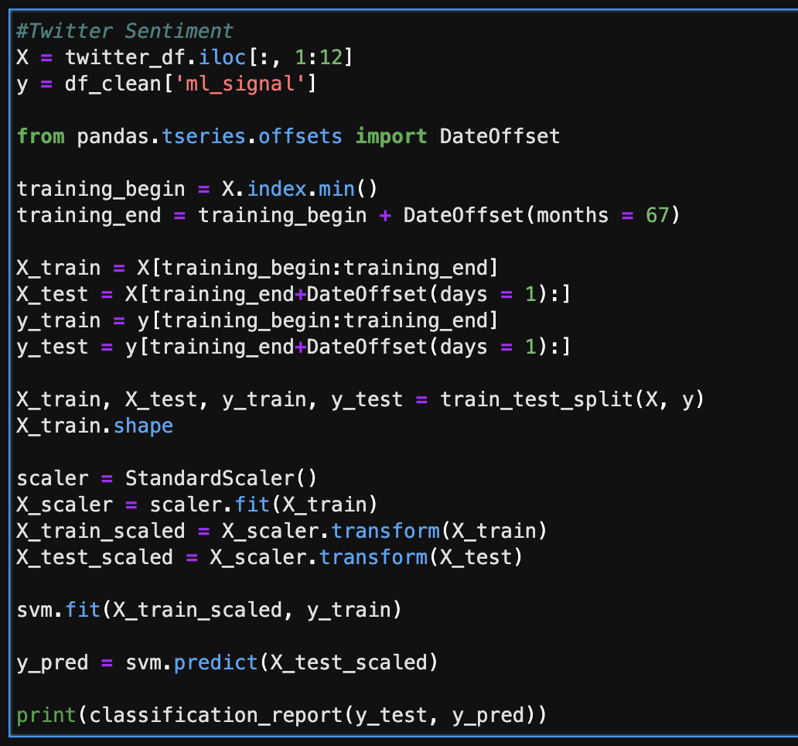
SVM
Created DataFrames for each platform to analyze which provided the best trading accuracy
67 month training period runs from Nov 2016 to current
Notes:
Jack

Slide 12
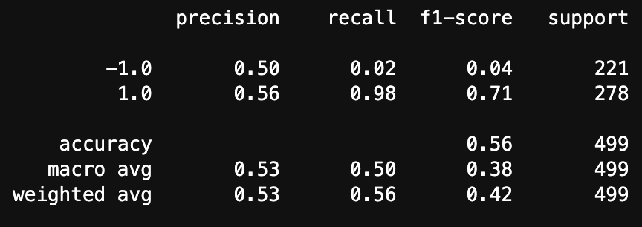
Trading Accuracy by Platform - Reddit
Notes:
Jack

Slide 13
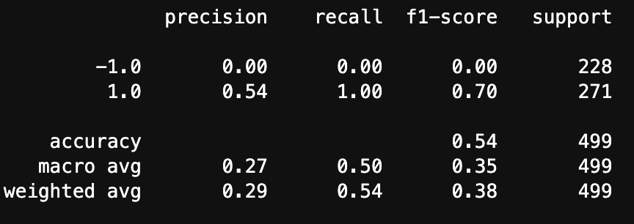
Trading Accuracy by Platform - Twitter
Notes:
Jack

Slide 14
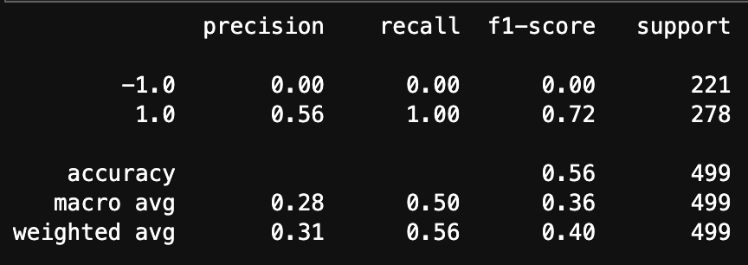
Trading Accuracy by Platform - BitcoinTalk
Notes:
Jack

Slide 15
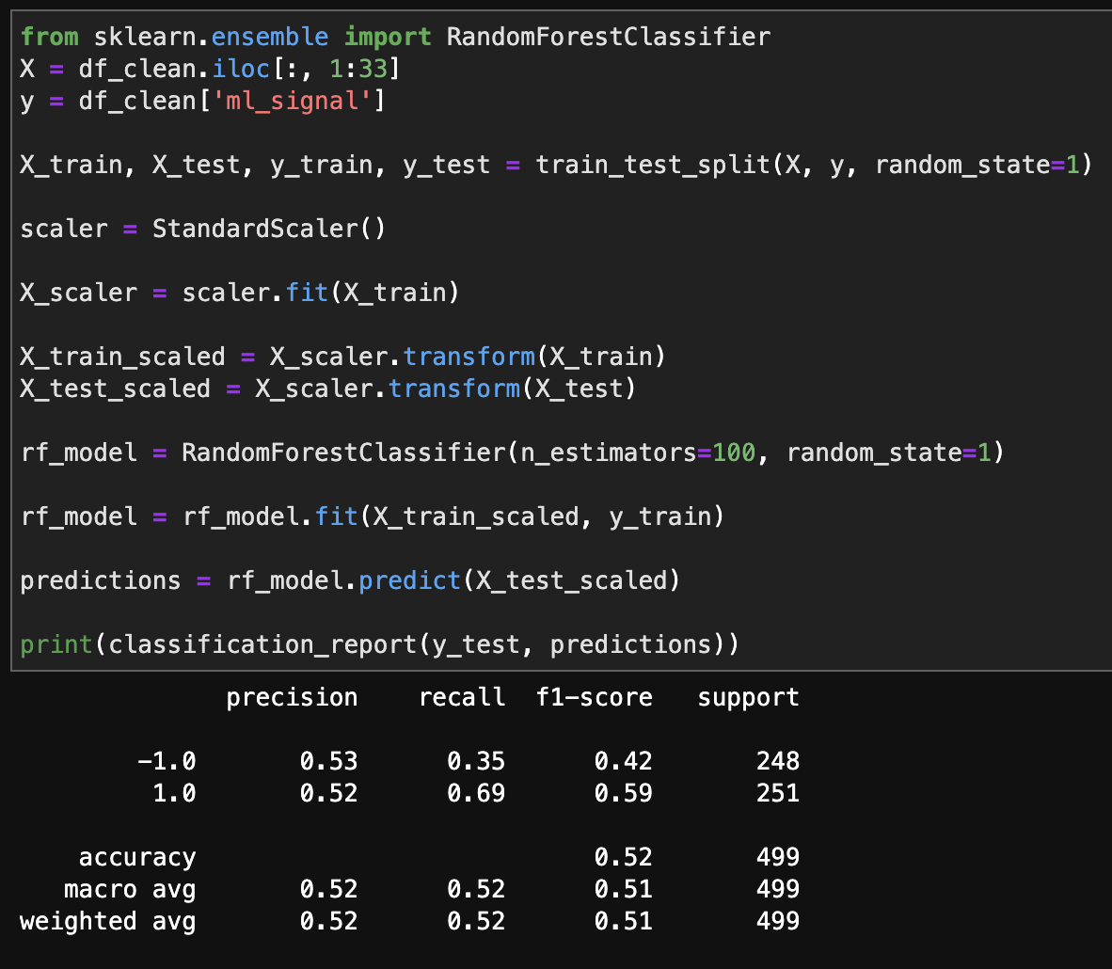
Random Forest
RF model serves as a better overall model as compared to SVM
Has the ability to predict buy and sell signals
Provides the ability to classify features

Slide 16
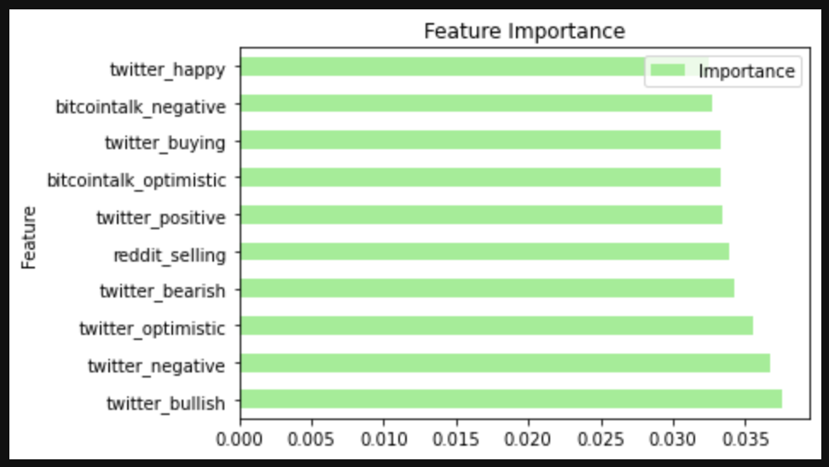
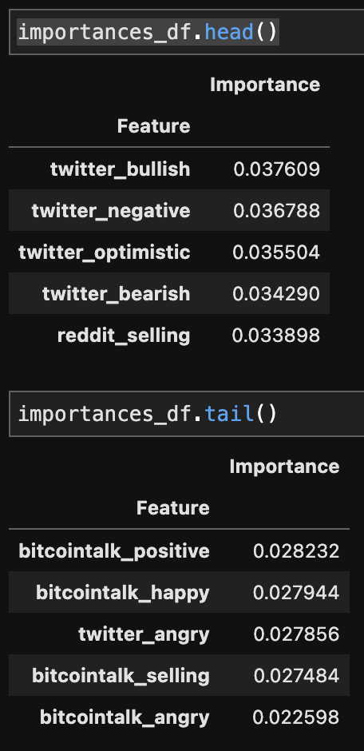
Most Important Features

Slide 17
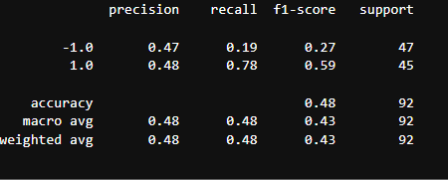
Slice Volatile Period July 2017 - July 2018. train_test_split
Notes:
Raj

Slide 18
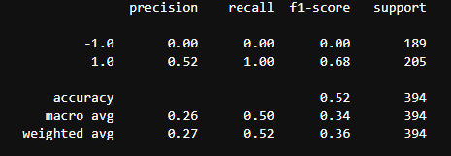
Slice Volatile Period July 2017 - July 2018. Training period from 11/01/2016-08/01/2017
Notes:
Raj

Slide 19
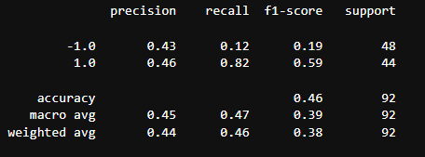
Slice Volatile Period Oct 2020-April 2022. train_test_split
Notes:
Raj

Slide 20
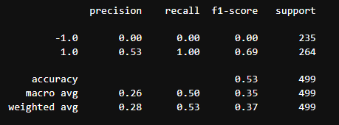
Slice Volatile Period Oct 2020-April 2022. Training period from 11/01/2016-04/01/2021
Notes:
Raj

Slide 21
Further Research Needed
Use Rolling averages
The more data the better
Twitter scraping to get up to date information and potentially cast a wider net
If successful in predicting signals, create a trading bot
Notes:
John

